Slide 1

Wind Chaser Co-Learning of Renewables Forecasts and Demand Response CEI Course Project
Members:
Yiwen Wu, Xiaoxiao Jia, Yize Chen, You Chen

Slide 2
Backgrounds
High Penetration of renewables (e.g., solar, wind, hydro…)
Price-sensitive user behaviors
Stochastic pattern of renewables generation:
How to predict the power generation?
Participation in the renewables-integrated market:
Can we cut down the total cost by using renewables?
Challenges

Slide 3
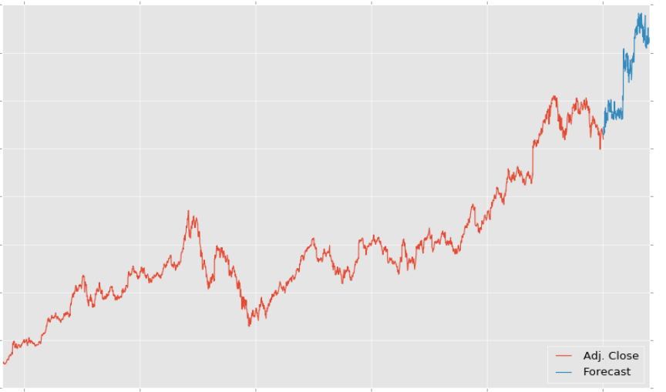
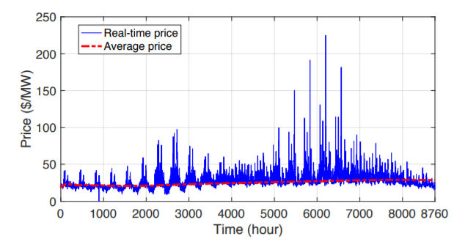
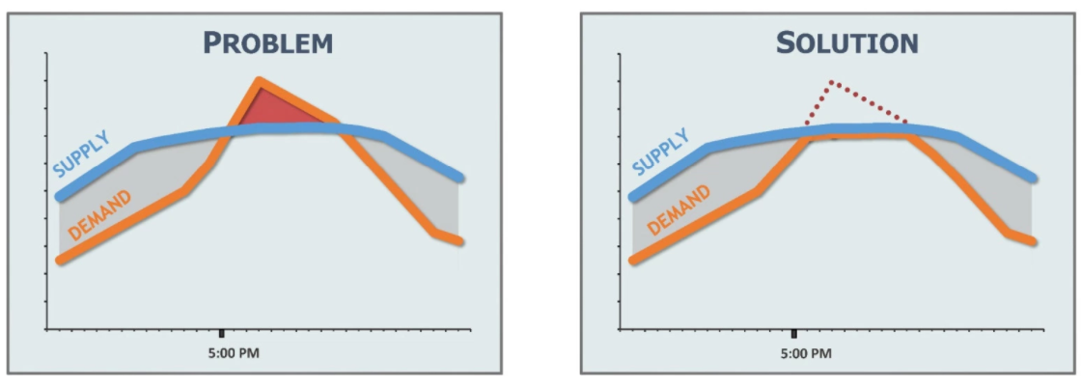
Problem Formulation
National Renewable Energy Laboratory (NREL) Wind Integration Datasets
PJM's Capacity Market, Reliability Pricing Model
Learning to predict
Given historical data, try to predict the future energy generation
Learning to make decision
When/how to use electricity given energy/price signal

Slide 4

Use Case
Get Visual and Data about Power Generation History
Input Time Frame
(year, month, day)
Select Site
Get Visual and Data about Future Power Generation Prediction
Correlation Analysis
Get Power and Weather Data
Select interested time horizon
Data Pre-processing
User Input
Call Machine learning Model
Get User Power Usage Suggestion
Input User Demand
Model Validation
Model Visualization
Notes:
As regenerative power generation mainly depends on the weather situation, most forecasting algorithms also take the weather forecast into account.
predicts the future power generation for a certain regenerative energy generator.

Slide 5
Software and Packages
Tensorflow powered by conv2d, simpleRNN, LSTMCell
Visualization: matplotlib, Matlab, Adobe Illustrator/PS
Data processing: Python(e.g., numpy, scipy, pandas) and Matlab (e.g., corrcoef, spectrogram)
Github!

Slide 6

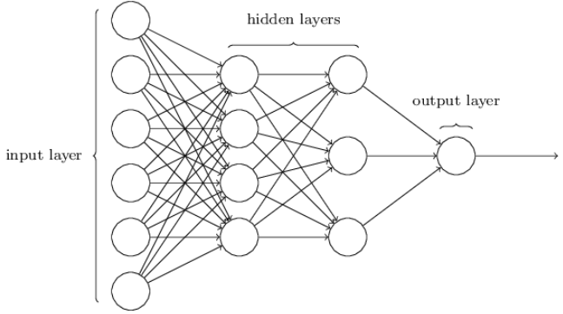
Neural Networks-NNs
inspired by the biological neural networks that constitute animal brains
Components
Neurons
Connections and weights
Propagation function
Learning Rule

Slide 7
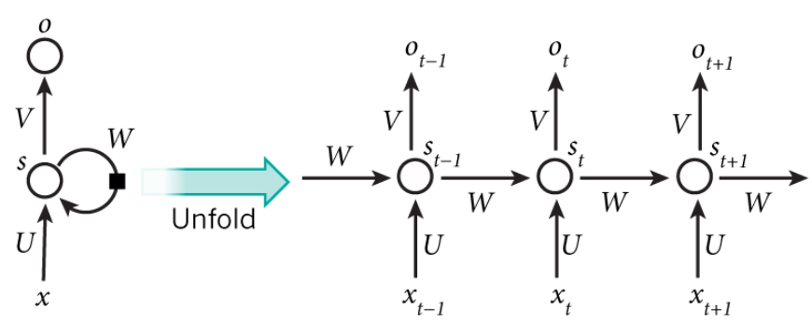
Recurrent Neural Networks-RNNs
Feedback connections
time-dependent
Tensorflow for RNN

Slide 8
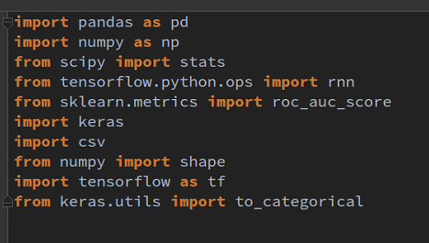
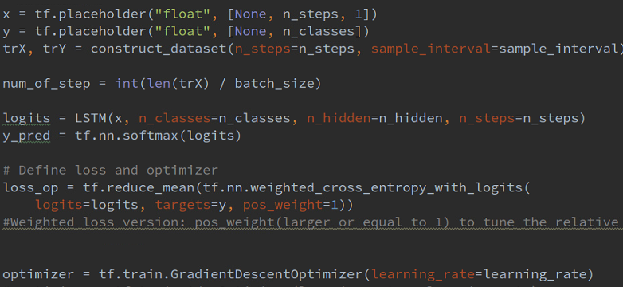
Initialize a neural network

Slide 9
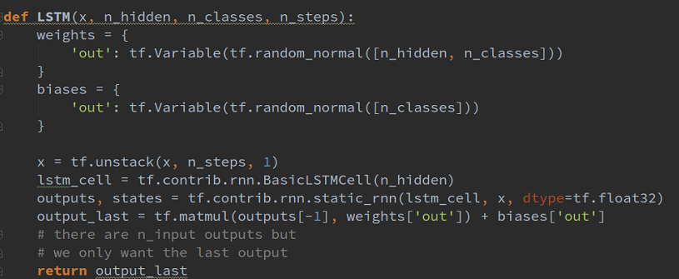
Build the RNN Graph

Slide 10
Reinforcement Learning for Decision Making
At time slot t, electricity user has to decide whether to use
a. Wind energy?
b. Traditional energy?
Main objective: minimize the total costs
Main obstacle: wind energy production/price is stochastic!

Slide 11

Reinforcement Learning for Decision Making
Problem Formulation
At time t
Given current observations (energy price ) and
past actions
Find the optimal policy given forecasts value maximizing rewards

Slide 12
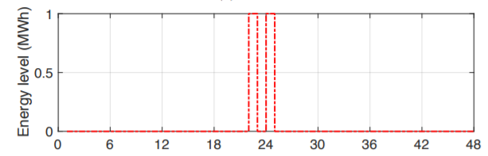
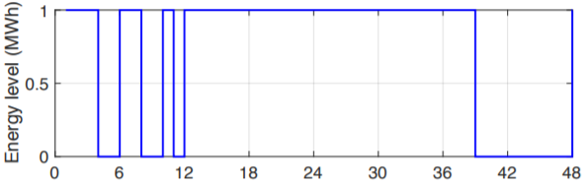
Reinforcement Learning for Decision Making
Compare to traditional decision-making process (e.g., Markov Decision Process, Linear Programming)
Incorporate forecasts information
Find the optimal solution
Higher computation complexity
Non-convergence problem

Slide 13
Thanks!
Q&A

